Slide 1
Topic : electric current
PREPARED BY: VED VIYAS ( CY-073 )
Class : Section: B

Slide 2

What is electric current ?
Electric current is the flow of electric charges through as the electrical conductor. A typical electrical conductor is a wire made of a metal such as copper, iron, or silver.
OR
When one coulomb charges flows through a conductor in one second then the current is said to be one Ampere.

Slide 3
Current is a scalar quantity.
SI unit of current is Ampere.
Formula: I = Q\t
Representation of Units:
1Ampere = 1Coulomb\ one Second

Slide 4
Steady Current :
If magnitude of rate of flow of charges remain constant then this is called steady current.
Direct Current (DC): Refers to the direction of current (flows in one direction only).-
Steady Current: Emphasizes the magnitude (constant value, not changing with time)
All steady currents are DC, but not all DC currents are perfectly steady (they might slightly vary in value, but still flow in one direction).

Slide 5
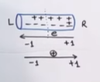
Two types of current on base of nature of charge:
Electronic Current:
The current due to flow of electron is called electronic current.
Its direction from Neg to Posi terminal of battery.
Flow from low potential to high potential.
2) Conventional current :. Current which flow from a high potential to low potential due to flow of positive charge.
Is direction is from positive to negative terminal of battery

Slide 6
So how was this assumption clarified, or when did it become known that it was just an assumption?
1. Background & Origin of Current Direction (History):- In the 1700s, the basic idea of electricity was being developed. - Benjamin Franklin (a scientist & inventor), while studying electricity, assumed that electric current is the flow of positive charges. - At that time, no one knew that electrons even existed.
2. Discovery of Electron (Actual Reality):- In 1897, J.J. Thomson discovered the electron — a negatively charged particle. - That’s when it was understood that the flow of electricity in metals or wires actually means the flow of electrons.
3. When electrons were discovered, it was proven that electrons actually move, not positive charges. - But by that time, all physics laws, circuit designs, and textbooks were already based on the concept of conventional current. - So, to maintain standardization and consistency, the conventional current direction (positive to negative) was kept.

Slide 7
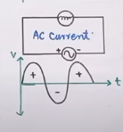
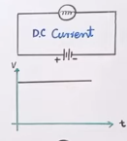
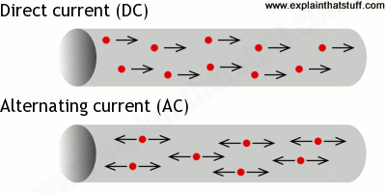
Two types current on direction base:
AC Current
A current that reserved its direction after equal intervals of time
Example: generators, power outlets
2) DC Current
DC is current that does not change the direction.
Example: battery, cells.

Slide 8
Thank you

